Slide 1
Slide 5
Python Cheatsheet
Advantages of Python
Developer friendly
Huge open source library
Data Types in Python
Int
float
string
tuple
Set
List
Ordered mutable list of elements
List has its own data type called ‘list’
append() – appends the value to the last of the list
pop() – removes the last element from the list
Example : [1,2,3,4,5]
Nested list - [ x**2 for x in [x**2 for x in range(11)]]
Dictionary
Unordered list of elements
Key value pairs
E.g: d={‘key 1’: [1,2,3] , ‘key 2’ : {‘a’:100,’b’:200}}
Tuple
Ordered immutable(can’t change/update) list of elements
Count(), index()
E.g: mytuple = ("apple", "banana", "cherry")
Set
Unordered, unchangeable
Does not allow duplicate values
E.g: thisset = {"apple", "banana", "cherry"}
Comparison Operators : ==, <=,>=,!=
Logical Operators : AND, OR, NOT
Tuple Unpacking - We need identical pairs for tuple unpacking
E.g : new_list = [(‘a’,100),(‘b’,300)]
For a,b in new_list
Print(a), Print(b)
Useful commands while using for/while loop
Pass : skips
Continue : skips and continues
Break : stops loop
Enumerate-indexing data
*Args
*Args – used to pass n number of arguments
E.g:
def myfunc(*integers):
return sum(integers)
myfunc(1,2,3,4)
Output :10
*Kwargs
*kwargs – used to pass n number of keyworded arguments
E.g:
def marks(**passandfail):
Return passandfail
marks(pass=’40’,fail=’30’)
Output: {‘pass’:’40’,’fail’:’30’
Lambda
Simplified function
E.g :
x = lambda a : a + 10 print(x(5))
Output : 15
Filter
Filters items out of a sequence
E.g: list(filter(lambda x:x>2,n) – shows values only greater than 2
Reduce
Applies same operations to items of a sequence
Uses result of operation as param of next operation
E.g : lis = [1, 3, 5, 6, 2, ]
print("The sum of the list elements is : ", end="")
print(functools.reduce(lambda a, b: a+b, lis))
print("The maximum element of the list is : ", end="")
print(functools.reduce(lambda a, b: a if a > b else b, lis))

Slide 2
Slide 5
NumPy+Pandas Cheatsheet
Command | Use
Np.array() | Creates an array
Np.arange() | Returns evenly spaced values within the specified interval
Np.ones() , Np.zeroes() | Generate arrays of ones & zeroes
Np.random.rand() | random samples from a uniform distribution over [0, 1)
Np.random.randn() | Return a sample (or samples) from the "standard normal" distribution. Unlike rand which is uniform
Np.append() | Appends data
Np.insert() | Inserts data
Np.delete() | Deletes data
Np.concatenate() | Concatenates multiple data into one
Np.split() | Splits one data into multiple
Np.add(),np.asubtract(),np.multiply(),np.divide() | Arithmetic Operations
Np.sqrt(),np.abs(),np.log() | Square root
Np.nan | Populates null value
Np.linspace() | Return evenly spaced numbers over a specified interval
Np.eye() | Creates an identity matrix
Np.max(),np.min() | Retrieves the maximum & minimum value of an array
Np.reshape() | Same data transforms to a new shape
Commands | Use
Pd.Series() | Creates one-dimensional labeled array
Pd.dataframe() | Creates two-dimensional labeled data structure with columns of different data types
Df.loc() | To retrieve the
Df.iloc() | To retrieve the index location of a value
Df.drop() | To drop a column/row
Df.reset_index() | To change the index value
Df.fillna() | To fill null values
Df.groupby() | To group columns
pd.concat() | To concatenate multiple column values
Pd.get_dummies() | To populate dummy values
Pd.merge() | To merge values of different columns
Pd.read_csv() | To read csv files
Df.shape() | Retrieves row and column count
Df.describe() | Summary of data statistics

Slide 3
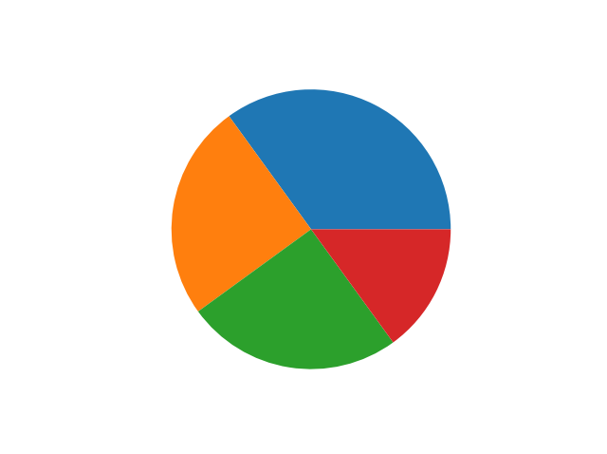
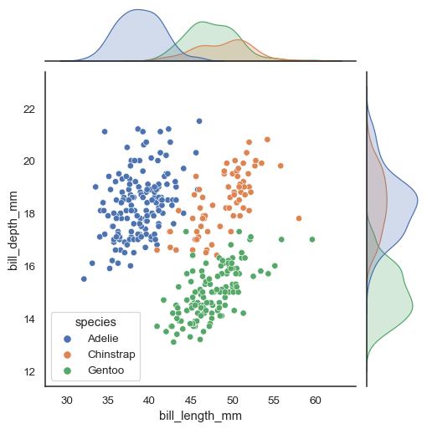
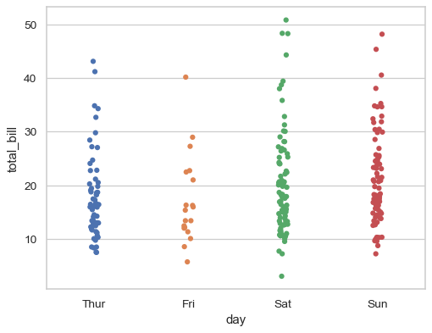
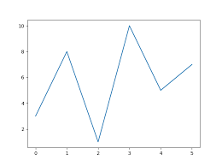
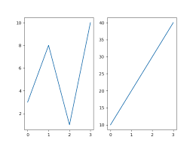
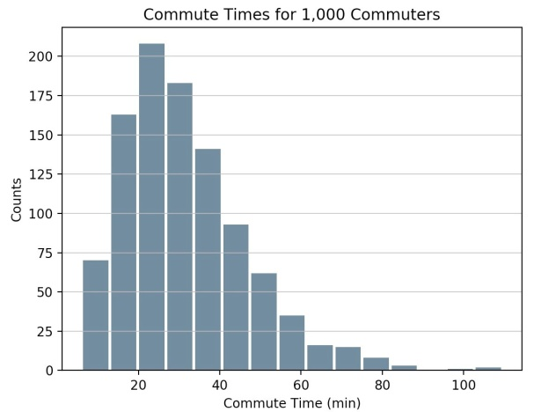
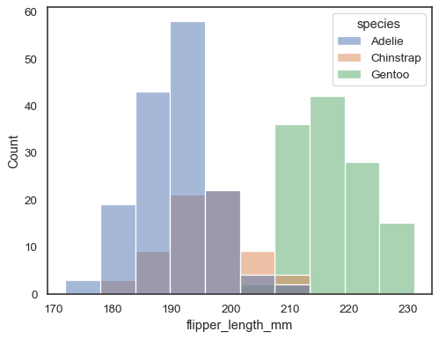
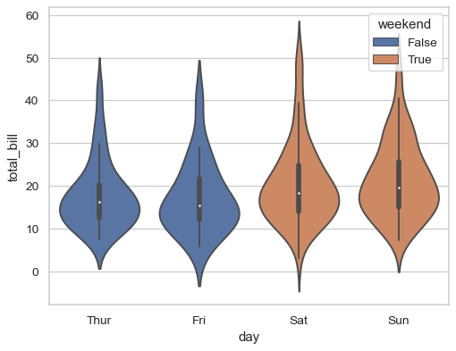
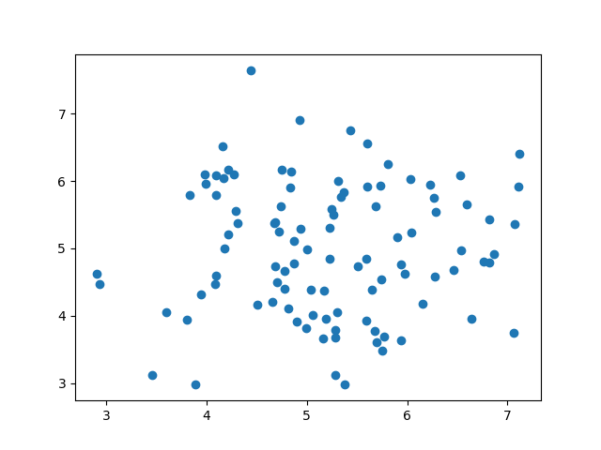
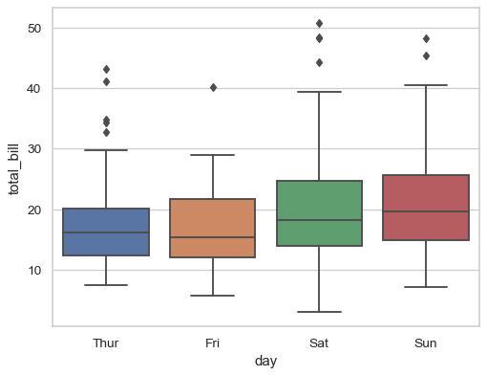
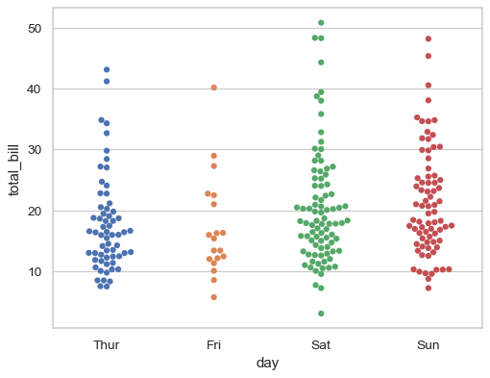
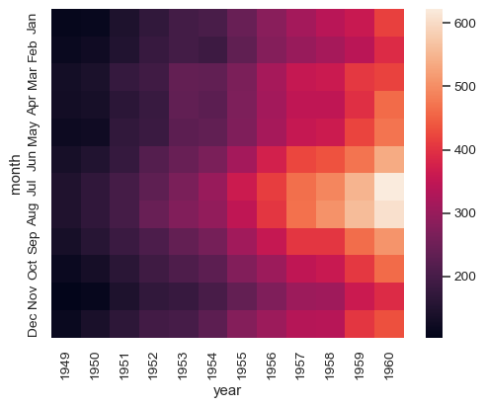
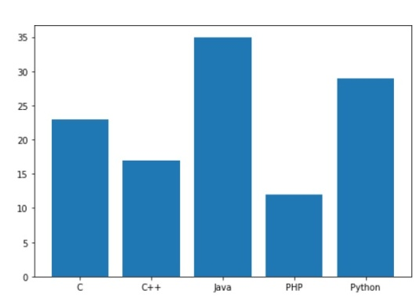
Slide 5
Visualization using Python Matplotlib, Seaborn
Matplotlib.pyplot as plt
plt.plot(), plt.subplot()
Sns.jointplot()
Sns.stripplot()
plt.pie(x, y)
plt.hist()
Sns.violinplot()
Sns.histplot()
plt.scatter(x, y)
Seaborn as sns
Sns.boxplot()
Sns.swarmplot()
Sns.heatmap()
plt.bar(x, y)

